Slide 1

An Introduction to active inference
Ryan Smith

Slide 2
What is active inference?
A framework for selecting actions under uncertainty
Jointly models perception, learning, and choice
Based on Bayesian inference
Biologically plausible form of approximate inference
Balances information-seeking and reward-seeking
When do I first take action to reduce uncertainty?
When do I try to immediately seek goals/rewards?
Associated with a neural process theory that can generate empirical predictions
fMRI
EEG

Slide 3
What is active inference?
Similar to RL, it is a framework, not a single model
Models in this framework tend to be united by one or both of the following:
Action selection based on minimizing expected free energy
Perception based on minimizing variational free energy
Typically implemented through message passing algorithms
In this lecture, I will focus on the “vanilla” active inference model
But note that there are other models
“sophisticated inference” – recursive decision tree search
“sophisticated learning” – planning to learn through simulation

Slide 4
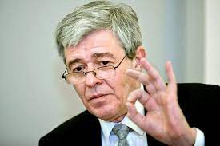
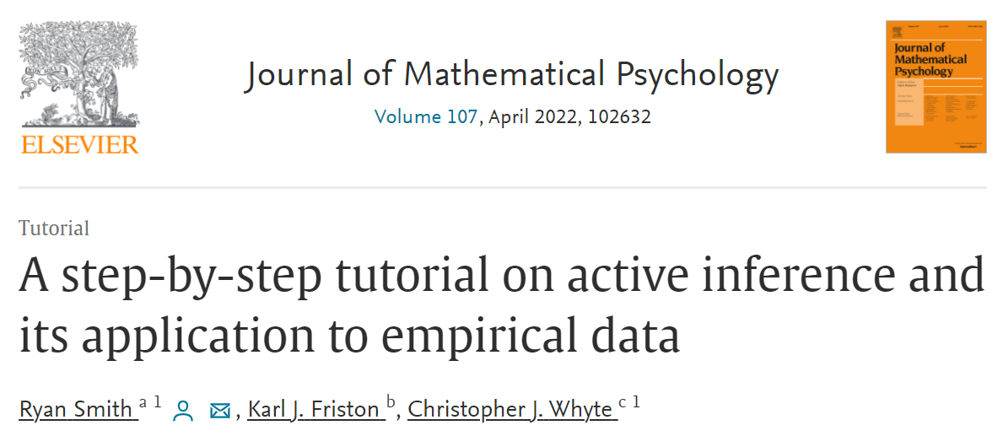
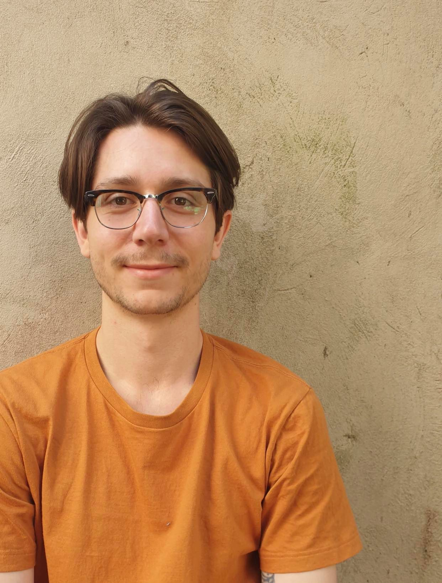
Tutorial
Most of this talk will draw from our recent tutorial:
Karl Friston
Christopher Whyte
Will also cover in more detail on Saturday!

Slide 5
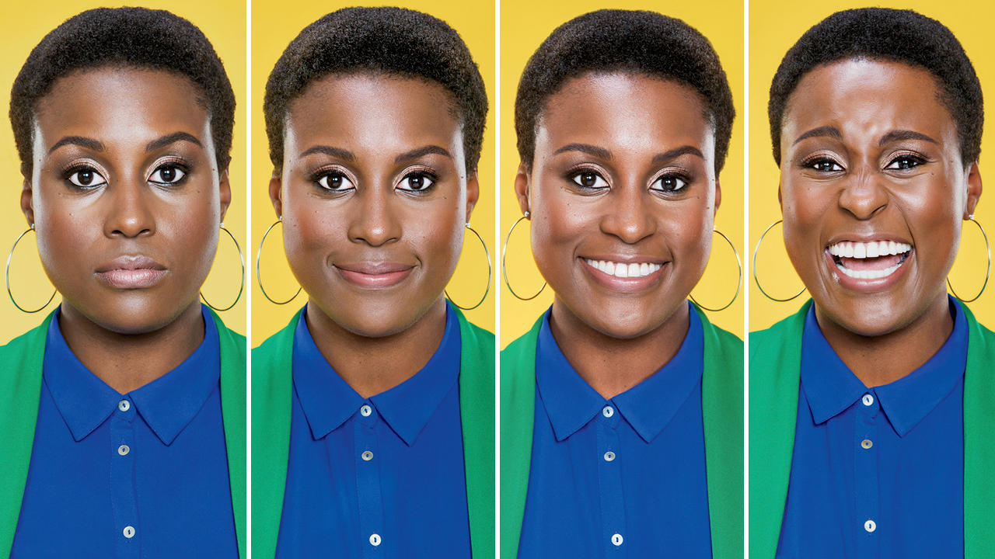
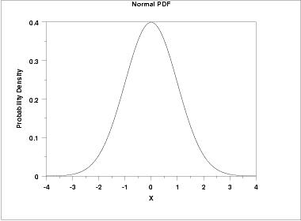
Social inference example
How friendly is this person?
Probability
Unfriendly
Neutral
Friendly
Ambiguous Expression

Slide 6
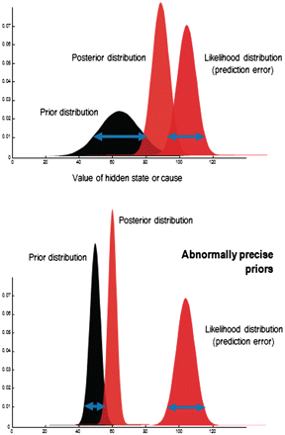
How do we solve this inference problem?
Bayes’ theorem
$$p\left(friendly | face\right)∝p\left(face | friendly\right)p(friendly)$$
Perceived as mildly unfriendly
Unfriendly
Neutral
Probability
Unfriendly
Neutral
Friendly
Ambiguous Expression

Slide 7
Precise prior expectations?
Bayes’ theorem
$$p\left(friendly | face\right)∝p\left(face | friendly\right)p(friendly)$$
Unfriendly
Perceived as more unfriendly
Neutral
Probability
Unfriendly
Neutral
Friendly
Ambiguous Expression

Slide 8
Active inference: taking action to improve inference
How friendly is this person?
Probability
Unfriendly
Neutral
Friendly
Ambiguous Expression
Say hi and see what happens?

Slide 9
Active inference: taking action to improve inference
“Hi!”
How friendly is this person?
Probability
Unfriendly
Neutral
Friendly
Ambiguous Expression
Say hi and see what happens?
Start a conversation if you expect it will be rewarding!

Slide 10
Formalism

Slide 11
Basics: Inference and Choice
Action selection is based on computing a term called expected free energy (G )
This measures expected reward and expected information gain
Lower = more expected reward and/or more expected information
Perceptual inference is based on a term called variational free energy (F )
This measures change in predictive accuracy and model complexity
Lower = more accurate and/or less complex
So we want to find beliefs and actions that minimize both

Slide 12
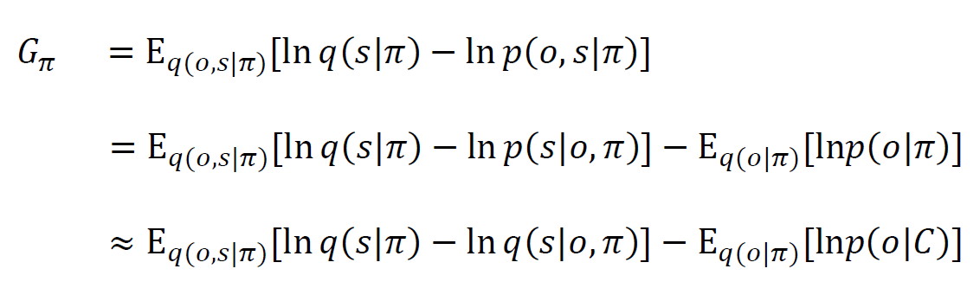
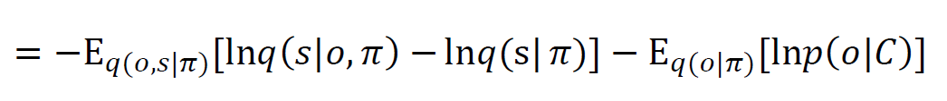
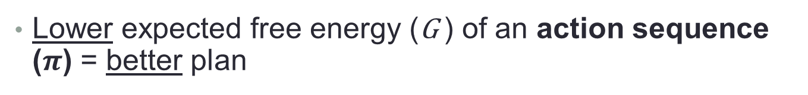
Expected free energy
Lower expected free energy (G ) of an action sequence ($π$) = better plan
Hidden States
(must be inferred from observations)
Preferred outcomes
(goal or reward)
Observations
(also called outcomes)
$q$ = denotes approximate distributions: best guess about the posterior probabilities

Slide 13
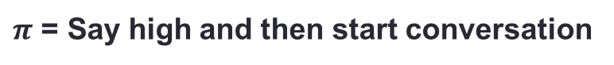
Expected free energy
Lower expected free energy (G ) of an action sequence ($π$) = better plan
“Epistemic value”
“Pragmatic value”
–
“How much do I expect beliefs will change after a new observation if I choose this plan?”
Expected probability of preferred outcomes if I choose this plan
Will I learn whether she is friendly?
Do I enjoy friendly conversation?
$π$ = Say high and then start conversation

Slide 14
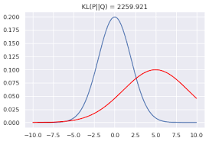
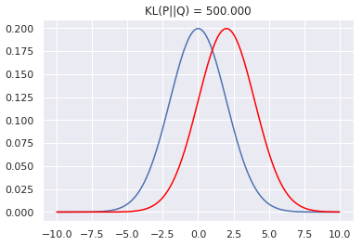
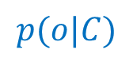
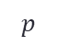
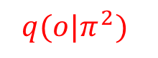
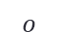
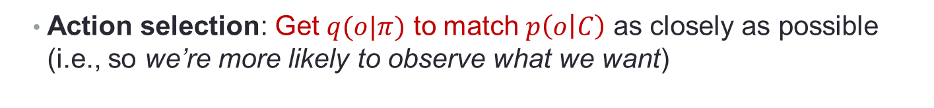

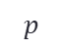
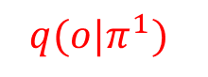


Reward-seeking
Action selection: Get $q(o|π)$ to match $p\left(o | C\right)$ as closely as possible (i.e., so we’re more likely to observe what we want)
$$Large divergence$$
$$Small divergence$$
$$p$$
$$p$$
$$o$$
$$o$$
$$p(o|C)$$
$${q(o|π}^{1})$$
$$p(o|C)$$
$${q(o|π}^{2})$$
Preferred
Expected
Preferred
Expected

Slide 15
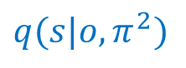
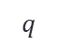
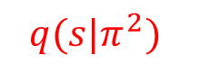
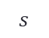
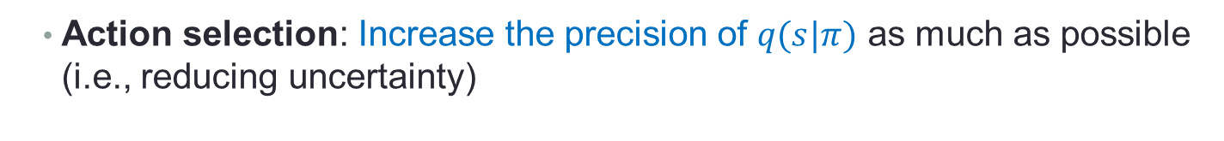
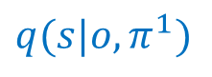
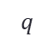
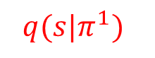


Information-seeking
Action selection: Increase the precision of $q(s|π)$ as much as possible (i.e., reducing uncertainty)
$$Large change$$
$$Small change$$
$$q$$
$$q$$
$$s$$
$$s$$
$$q{(s|o,π}^{1})$$
$${q(s|π}^{1})$$
$$q{(s|o,π}^{2})$$
$${q(s|π}^{2})$$
After
Before
After
Before

Slide 16
Expected free energy
Provides a principled approach to arbitrating the explore-exploit dilemma:
“Epistemic value”
“Pragmatic value”
–
“How much do I expect beliefs will change after a new observation if I choose this plan?”
Expected probability of preferred outcomes if I choose this plan
Action selection is initially information-seeking
epistemic term dominates
Then the agent leverages that information to bring about preferred outcomes

Slide 17
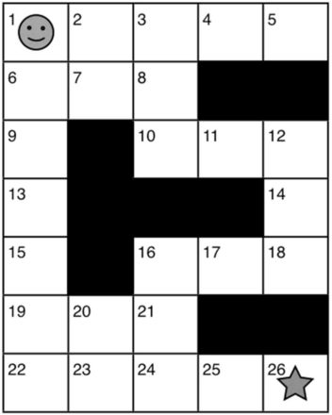

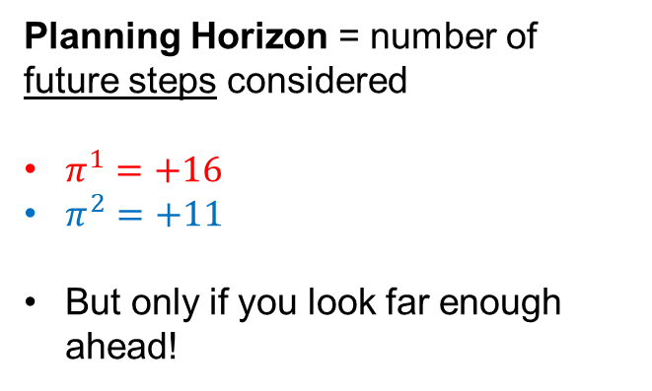
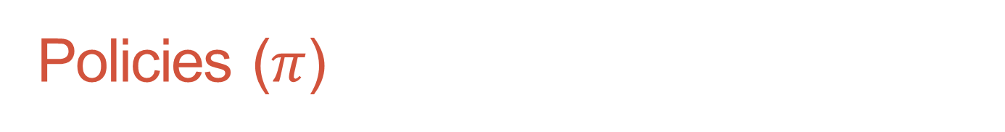
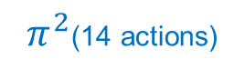
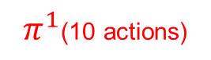
Policies ($π$)
Possible plans (action sequences) – a function of time
Different meaning than RL, where a “policy” instead refers to a mapping from states to actions
$π^{1}$(10 actions)
$π^{2}$(14 actions)
Start
Planning Horizon = number of future steps considered
$π^{1}=+16$
$π^{2}=+11$
But only if you look far enough ahead!
Something difficult (-10)
All other states = -3
Goal
(+50)

Slide 18
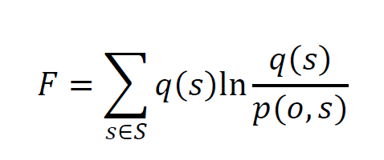
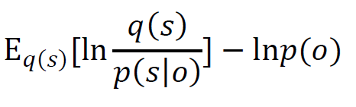
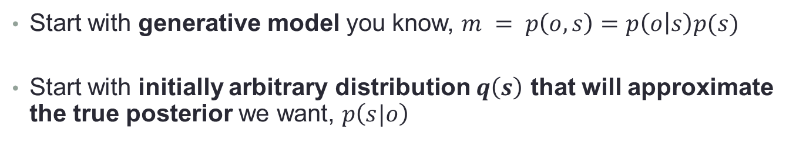
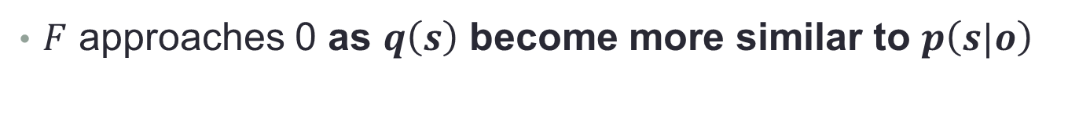
Perception: Variational free energy
Start with generative model you know, $m = p\left(o,s\right)=p\left(o | s\right)p(s)$
Start with initially arbitrary distribution $q\left(s\right)$ that will approximate the true posterior we want, $p\left(s|o\right)$
Difference between approximate and true posterior
“How surprising is this observation under my model?”
$F$ approaches 0 as $q\left(s\right)$ become more similar to $p\left(s|o\right)$

Slide 21
Complexity minus accuracy
Complexity
+
Prediction error
Complexity
Accuracy
$F =D_{KL}\left[q\left(s\right)||p(s)\right]−E_{q\left(s\right)}[lnp\left(o|s\right)]$
“How much do beliefs
change?”
“How accurate are
my predictions?”
Complexity: Move posterior beliefs as little as possible from prior beliefs
Keep beliefs as simple/parsimonious as possible – avoid overfitting
Accuracy: Adjust beliefs to make the most accurate predictions possible

Slide 22
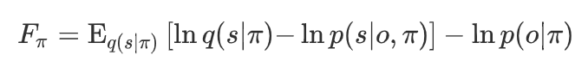
Variational vs. Expected free energy

Slide 23
Computing G and F: under a generative model of a task

Slide 24
Graphical model depiction of active inference
Here arrows denote conditional dependencies
Circles correspond to random variables that are updated during inference
Squares indicate fixed parameters
Can be a bit daunting for those new to this area
We will walk through this step by step

Slide 25
Example

Slide 26
Example

Slide 27
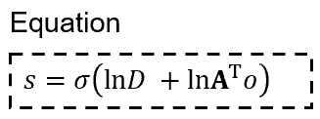
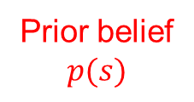
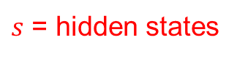
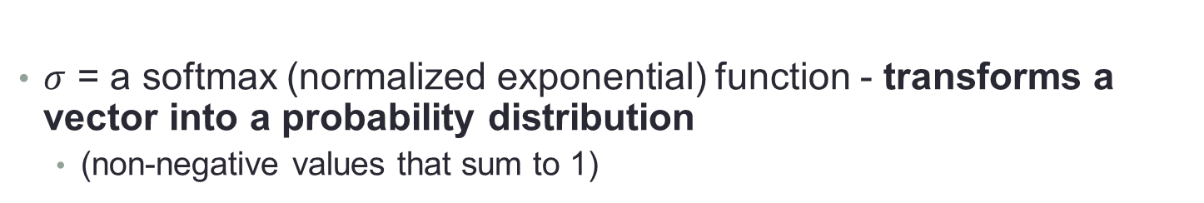
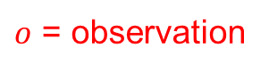
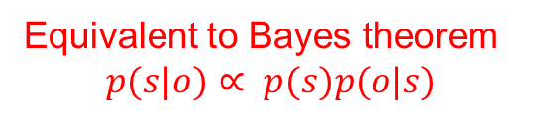
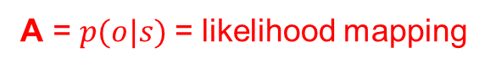
Static perception
Equivalent to Bayes theorem
$$p(s|o)∝ p(s)p(o|s)$$
$s$ = hidden states
Prior belief
$$p(s)$$
A = $p(o|s)$= likelihood mapping
$o$ = observation
$σ$ = a softmax (normalized exponential) function - transforms a vector into a probability distribution
(non-negative values that sum to 1)

Slide 28
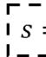
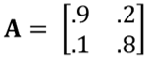
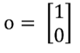
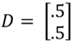
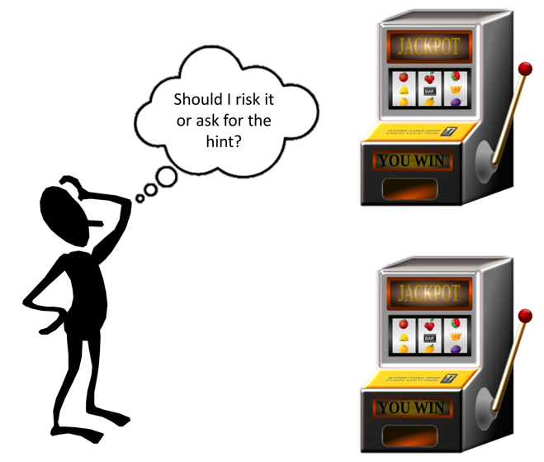
Static perception
?
Left machine is more likely to be the better one
L R
p(hint=left machine | left machine is better) = .9
Hint = left machine
L
R
Both machines are equally likely

Slide 29
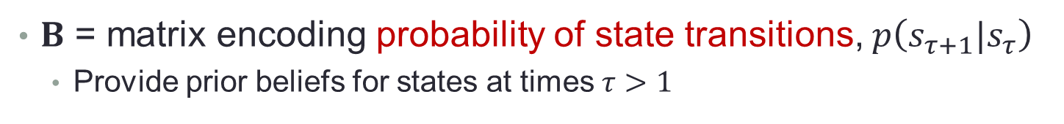


Dynamic perception
$B$ = matrix encoding probability of state transitions, $p\left(s_{τ+1}|s_{τ}\right)$
Provide prior beliefs for states at times $τ>1$
Prior, $p\left(s\right)$
Likelihood, $p(o|s)$
† indicates a transpose and then normalizing columns

Slide 30
Dynamic perception
$B$ = matrix encoding probability of state transitions, $p\left(s_{τ+1}|s_{τ}\right)$
Provide prior beliefs for states at times $τ>1$
Prior, $p\left(s\right)$
Likelihood, $p(o|s)$
† indicates a transpose and then normalizing columns

Slide 31

Dynamic perception
Allows you to update beliefs about earlier time points when getting observations at later time points ($τ$ vs. $t$)
Prior from the future
† indicates a transpose and then normalizing columns

Slide 32


Variational (Marginal) Message passing
These equations implement variational message passing
An efficient way to do approximate posterior inference on a graph
Can be shown to minimize variational free energy ($F$)

Slide 33


Variational Message passing
+
+

Slide 34

Variational Message passing
+
$$q(s_{1})$$
+

Slide 35


Variational Message passing
$$q(s_{1})$$
$$q(s_{2})$$
$$q(s_{3})$$
+

Slide 36

Variational Message passing
Iterate this process until convergence to a stable $s$ for each $τ$
+
+
+
+
+

Slide 37


Variational Message passing
Iterate this process until convergence to a stable $s$ for each $τ$
$$q(s_{1})$$
$$q(s_{2})$$
$$q(s_{3})$$

Slide 38
Variational Message passing
Iterate this process until convergence to a stable $s$ for each $τ$
+
+
+
+
+

Slide 39
Variational Message passing
Let’s now assume beliefs over states have converged
$$q(s_{1})$$
$$q(s_{2})$$
$$q(s_{3})$$

Slide 40

Variational Message passing
Add next observation
Repeat iterative message passing until you again reach convergence, etc.
$$q(s_{1})$$
$$q(s_{2})$$
$$q(s_{3})$$

Slide 41
Variational Message passing
Also represents a possible way to think about the messages passed between neurons in the brain
Message passing can be formulated in terms of minimizing prediction error
$$q(s_{1})$$
$$q(s_{2})$$
$$q(s_{3})$$

Slide 42


Example
$$p\left(s_{τ+1} | s_{τ}\right)=$$
$$B=\left[\begin{matrix}1 & 0 \\ 0 & 1\end{matrix}\right]$$
If the left machine is better at time point 2
it will still be better at time point 3
with probability = 1

Slide 43





Example
$$s_{1}$$
$$s_{2}$$
$$s_{3}$$
$$B=\left[\begin{matrix}1 & 0 \\ 0 & 1\end{matrix}\right]$$
Time
Darker = higher probability
Cyan dot = true state/outcome/action

Slide 44
Example
$$s_{1}$$
$$s_{2}$$
$$s_{3}$$
$$B=\left[\begin{matrix}1 & 0 \\ 0 & 1\end{matrix}\right]$$
Time
Darker = higher probability
Cyan dot = true state/outcome/action

Slide 45





Neural process theory
$$q(s)$$
$$s_{1}$$
$$s_{2}$$
$$s_{3}$$
ERPs
Time
Rate of change in $q(s)$

Slide 46

Example
$$p\left(s_{τ+1} | s_{τ}\right)=$$
$$B=\left[\begin{matrix}.7 & .3 \\ .3 & .7\end{matrix}\right]$$
If the left machine is better at time point 2
it will still be better at time point 3
with probability = .7

Slide 47





Example
$$s_{1}$$
$$s_{2}$$
$$s_{3}$$
$$B=\left[\begin{matrix}.7 & .3 \\ .3 & .7\end{matrix}\right]$$
Time
Darker = higher probability
Cyan dot = true state/outcome/action

Slide 48
Example
$$s_{1}$$
$$s_{2}$$
$$s_{3}$$
$$B=\left[\begin{matrix}.7 & .3 \\ .3 & .7\end{matrix}\right]$$
Time
Darker = higher probability
Cyan dot = true state/outcome/action

Slide 49





Neural process theory
$$q(s)$$
$$s_{1}$$
$$s_{2}$$
$$s_{3}$$
ERPs
Time
Rate of change in $q(s)$

Slide 50



Evidence for predicted ERPs
A few papers have now shown that simulated ERPs based on this theory can predict or reproduce ERP findings in the EEG literature.

Slide 51


Inattentional blindness task (P300)
Oddball task (mismatch negativity)
Interoception (LPP)

Slide 52
Decision-making
Policies (plans):
possible sequences of actions
For example:
Take hint and then choose left machine
Immediately choose left
…
Transitioning from the “start” state to the “take the hint state”
Each policy entails a different sequence of state transitions
Transitioning from the “start” state to the “choose left machine”

Slide 53
Perform message passing for each policy in parallel
1
2
Policy 1
1
3
Policy 2

Slide 54

Beliefs about transitions (actions), P(s_{t+1}|s_{t},π)
Take the hint
S H L R
Choose the left machine
Choose the right machine

Slide 55
Beliefs about transitions (actions), P(s_{t+1}|s_{t},π)
Take the hint
S H L R
Choose the left machine
Choose the right machine

Slide 56

Preferred observations (reward)
Policies with the lowest expected free energy will be those expected to:
generate preferred outcomes
maximize information gain
Expected free energy:
How good is each policy?
Preference precision
)
)

Slide 57




Graphical model of POMDP structure
Each policy entails a different set of state transitions
This in turn predicts different sequences of observations
These jointly allow evaluation of $G_{π}$
–
“Epistemic value”
“Pragmatic value”
Low $G_{π}$ = high probability of choosing that policy
$α$ controls randomness in choice

Slide 58



Took the hint and then chose the left machine
$C$ = moderately precise preference distribution
$$q(s)$$
Time
Time
Time
Darker = higher probability
Cyan dot = true state/outcome/action

Slide 59
Took the hint and then chose the left machine
$C$ = moderately precise preference distribution
$$q(s)$$
Time
Time
Time
Darker = higher probability
Cyan dot = true state/outcome/action

Slide 60


$C$ = very precise preference distribution (risk-seeking)
Took a guess immediately and lost
$$q(s)$$
Time
Time
Time
Darker = higher probability
Cyan dot = true state/outcome/action

Slide 61
$C$ = very precise preference distribution (risk-seeking)
Took a guess immediately and lost
$$q(s)$$
Time
Time
Time
Darker = higher probability
Cyan dot = true state/outcome/action

Slide 62
Increased exploitation with learning
Each trial where it infers the left machine is better, it increases its prior belief that the left machine will be better in the future
This elevated confidence reduces the drive to seek information
Preference precision also moderates the influence of action on these dynamics
Consider both stable and volatile environments

Slide 63
Increased exploitation with learning
Darker = higher probability
Blue circle = first action
Green = win
Black = loss
Left machine is always better

Slide 64
Increased exploitation with learning
Darker = higher probability
Blue circle = first action
Green = win
Black = loss
Left machine is always better

Slide 65
Increased exploitation with learning
Right machine unexpectedly becomes better
Darker = higher probability
Blue circle = first action
Green = win
Black = loss

Slide 66
Increased exploitation with learning
Right machine unexpectedly becomes better
Darker = higher probability
Blue circle = first action
Green = win
Black = loss

Slide 67

Graphical model of POMDP structure
The vector $E$ is prior over policies $p(π)$, which allows one to model habits and habit learning
$γ$ is the expected precision of $G$
A weighting parameter based on confidence in the agent’s action model
Lower confidence increases the influence of habits

Slide 68

Graphical model of POMDP structure
$γ$can be updated based on changes in confidence after new observations
These updates have been proposed to relate to phasic dopamine responses within the neural process theory
Similar to a reward prediction error, but with respect to G
See tutorial paper!

Slide 69




Neural process theory
One study has shown that $γ$ updating is correlated with neural activity in midbrain dopamine regions as well as dopaminergic targets
Theory remains to be thoroughly tested

Slide 70
Active Learning

Slide 71

Active Learning
Two types of exploration:
State exploration: seeking information about hidden states
Left machine better vs. right machine better (take hint)
Parameter exploration: seeking information about parameters
Choosing the left machine to learn the reward probabilities, $p(o|s)$
Driven by an added term to the expected free energy when learning is included

Slide 72




Active Learning
The probability that p(o|s) has a particular shape
Intuition
“Epistemic value”
“Pragmatic value”
“Novelty”
Drive toward the “Right” state
Normalized (a)
Left
Right
Left
Right
$$\left[\begin{matrix}0 \\ 30 \\ 30\end{matrix}\begin{matrix} 0 \\ 1 \\ 1\end{matrix}\right]$$
Start
$$\left[\begin{matrix}0 \\ 0.5 \\ 0.5\end{matrix}\begin{matrix} 0 \\ 0. 5 \\ 0.5\end{matrix}\right]$$
Lose
A =
Start
Win
Lose
Higher counts =
less exploratory drive
Win
Concentration parameters (“counts”)

Slide 73


Active Learning
The probability that p(o|s) has a particular shape
Intuition
Forgetting rate
Learning rate
Normalized (a)
Left
Right
Left
Right
$$\left[\begin{matrix}0 \\ 30 \\ 30\end{matrix}\begin{matrix} 0 \\ 2 \\ 1\end{matrix}\right]$$
Start
$$\left[\begin{matrix}0 \\ 0.5 \\ 0.5\end{matrix}\begin{matrix} 0 \\ 0. 66 \\ 0.33\end{matrix}\right]$$
Lose
A =
Start
Win
Lose
Higher counts =
less exploratory drive
Win
Concentration parameters (“counts”)

Slide 74


Active Learning
1
2
3
Three slot machines with unknown reward probabilities

Slide 75
Summary
Active inference describes perception, learning, and decision-making in terms of approximate Bayesian inference
It uses a variational message passing scheme that is biologically plausible and can generate neuroscientific predictions
It includes reward-seeking as well as information-seeking drives
Active learning: Additional information-seeking drive when trying to learn model parameters (e.g., reward probabilities)

Slide 76
How are these models useful?
As with other modeling approaches:
Can build models that represent precise hypotheses about the mechanisms generating clinical phenomena of interest
Can fit those models to empirical data and test those hypotheses
Requires designing appropriate behavioral tasks
These models are most well-suited for modeling cognitive processes that involve partial observability (state uncertainty) and the need for exploration (to reduce uncertainty)

Slide 77







Empirical Studies
Affective & Substance Use Disorders:
Slower learning from negative outcomes
Greater Decision Uncertainty
Inflexible Interoceptive Precision Updating
FMRI/EEG Correlates

Slide 78



Thanks!
Christopher Whyte
Karl Friston

